Slide 1
Mathematical Modeling
of Viral dynamics (HIV / Hepatitis)
and Resistance Evolution
From Theory to Clinical Implications
Avidan U Neumann
Goodman Faculty of Life Sciences
Bar-Ilan University, Israel

Slide 2
HIV Kinetics during Anti-Viral Therapy
Ritonavir Mono-therapy - Ho, Neumann, Perelson et al, Nature, 1995
Notes:
I would like to thank my collaborators at Hopital Pitie-Salpetriere
in Paris for putting lots of effort in this project.
Patients were treated in Christine Katlama’s group
by Roland Tubiana and others.
Shlomo Mayan from Hadassah (Jerusalem)
was very helpful in locating the preliminary step patients.
Immunological studies were done by Taishen Li in Brigitte Autran’s group,
and virology by Vincent Calvez and Catherine Robert in Henri Agut’s lab.
Alain Mallet (and Brigitte) helped me with conceptualization and analysis
of the data.

Slide 3
0th Order Model of Viral Dynamics
dV/dt = P - a*V
Approximately viral production
is totally blocked (P=0)
Virus
V(t) = V₀ exp (-a*t)
log-linear slope is therefore <=a
Notes:
Although much is known about the dynamics of HIV ,
still a very important question is left open:
Is HIV responsible (directly or indirectly)
for CD4 cells death in-vivo during progression to AIDS ?
In order to tackle this question,
and test the different models that may answer it,
we have presented to ourselves the next goals:
1) Study the dynamics of HIV replication in-vivo,
in addition to that of HIV decay,
which is what was mostly studied up to now.
2)
3)

Slide 4
HIV Kinetics during Anti-Viral Therapy
Log-Linear decline of HIV vital load
(0.5/day,
t_{1/2}= 2 d) in most patients
Ritonavir Mono-therapy - Ho, Neumann, Perelson et al, Nature, 1995
Notes:
I would like to thank my collaborators at Hopital Pitie-Salpetriere
in Paris for putting lots of effort in this project.
Patients were treated in Christine Katlama’s group
by Roland Tubiana and others.
Shlomo Mayan from Hadassah (Jerusalem)
was very helpful in locating the preliminary step patients.
Immunological studies were done by Taishen Li in Brigitte Autran’s group,
and virology by Vincent Calvez and Catherine Robert in Henri Agut’s lab.
Alain Mallet (and Brigitte) helped me with conceptualization and analysis
of the data.

Slide 5
0th Order Model of Viral Dynamics
dV/dt = P - a*V
Approximately viral production
is totally blocked (P=0)
Virus
V(t) = V₀ exp (-a*t)
log-linear slope is therefore <=a
Rapid viral dynamics
(P > 10¹⁰ virions/day/patient)
HIV; HBV; HCV; CMV;
Other viruses ?
Notes:
Although much is known about the dynamics of HIV ,
still a very important question is left open:
Is HIV responsible (directly or indirectly)
for CD4 cells death in-vivo during progression to AIDS ?
In order to tackle this question,
and test the different models that may answer it,
we have presented to ourselves the next goals:
1) Study the dynamics of HIV replication in-vivo,
in addition to that of HIV decay,
which is what was mostly studied up to now.
2)
3)

Slide 6
Understanding Therapy Effect on HCV
with Mathematical Models
HCV
Drop of 1-3 logs
(10-1000 fold)
in HCV levels
in blood during
first 1-2 days
of treatment
Lam, Neumann et al (Hepatology, 1997)
HIV
Drop of 1-2 logs
(10-100 fold)
in HIV levels
in blood during
first week
of treatment
Steady state
with fluctuations
of up to 3 fold
(-+ 0.5 log)
in time scale of
days- months
before treatment
(N > 100)
0.5
0
RNA eq/ml
-0.5
10
-1
Mean Decrease Log
-1.5
HIV
HCV
-2
-7
0
7
Days
Notes:
Although much is known about the dynamics of HIV ,
still a very important question is left open:
Is HIV responsible (directly or indirectly)
for CD4 cells death in-vivo during progression to AIDS ?
In order to tackle this question,
and test the different models that may answer it,
we have presented to ourselves the next goals:
1) Study the dynamics of HIV replication in-vivo,
in addition to that of HIV decay,
which is what was mostly studied up to now.
2)
3)

Slide 7
Basic Model of Viral Dynamics on Cellular Infection (CI) level
Target Cell
Infected
Cell
δ
Virus
Notes:
Although much is known about the dynamics of HIV ,
still a very important question is left open:
Is HIV responsible (directly or indirectly)
for CD4 cells death in-vivo during progression to AIDS ?
In order to tackle this question,
and test the different models that may answer it,
we have presented to ourselves the next goals:
1) Study the dynamics of HIV replication in-vivo,
in addition to that of HIV decay,
which is what was mostly studied up to now.
2)
3)

Slide 8
CI Model - Effect of Therapy
w/ INFECTED CELL as BLACK BOX
Target cells:
dT/dt = S + P(T) - d T - (1-η) β V T
Blocking Infection
Infected Cells:
dI/dt = (1-η) β V T - (δ) I
Blocking Infection
Free Virions:
dV/dt = (1-ε) p I - c V
Blocking Production
Notes:
Although much is known about the dynamics of HIV ,
still a very important question is left open:
Is HIV responsible (directly or indirectly)
for CD4 cells death in-vivo during progression to AIDS ?
In order to tackle this question,
and test the different models that may answer it,
we have presented to ourselves the next goals:
1) Study the dynamics of HIV replication in-vivo,
in addition to that of HIV decay,
which is what was mostly studied up to now.
2)
3)

Slide 9
HCV Bi-Phasic (IFN qd) Dose-dependent Decline
Rapid decline on days 0-2, strongly dose-dependent
Slower continuous decline after day 2
CORRECTION of Neumann et al, Science 1998 (Only Caucasian patients)
Notes:
Although much is known about the dynamics of HIV ,
still a very important question is left open:
Is HIV responsible (directly or indirectly)
for CD4 cells death in-vivo during progression to AIDS ?
In order to tackle this question,
and test the different models that may answer it,
we have presented to ourselves the next goals:
1) Study the dynamics of HIV replication in-vivo,
in addition to that of HIV decay,
which is what was mostly studied up to now.
2)
3)

Slide 10
Simulation of therapy BLOCKING : Infection Production
Notes:
Although much is known about the dynamics of HIV ,
still a very important question is left open:
Is HIV responsible (directly or indirectly)
for CD4 cells death in-vivo during progression to AIDS ?
In order to tackle this question,
and test the different models that may answer it,
we have presented to ourselves the next goals:
1) Study the dynamics of HIV replication in-vivo,
in addition to that of HIV decay,
which is what was mostly studied up to now.
2)
3)

Slide 11
Viral decline during treatment (detected)
steady state of HIV (?) eradication of HCV (?)
Notes:
Although much is known about the dynamics of HIV ,
still a very important question is left open:
Is HIV responsible (directly or indirectly)
for CD4 cells death in-vivo during progression to AIDS ?
In order to tackle this question,
and test the different models that may answer it,
we have presented to ourselves the next goals:
1) Study the dynamics of HIV replication in-vivo,
in addition to that of HIV decay,
which is what was mostly studied up to now.
2)
3)

Slide 12
Simulation BLOCKING Production
Empirical data from Rx of CHC with IFN QD:
Notes:
Although much is known about the dynamics of HIV ,
still a very important question is left open:
Is HIV responsible (directly or indirectly)
for CD4 cells death in-vivo during progression to AIDS ?
In order to tackle this question,
and test the different models that may answer it,
we have presented to ourselves the next goals:
1) Study the dynamics of HIV replication in-vivo,
in addition to that of HIV decay,
which is what was mostly studied up to now.
2)
3)

Slide 13
Possible Effects of IFN Dose
Target Cell
IFN blocks production/release of HCV from infected cells
Infected
Cell
Effectiveness in blocking replication exponentially affects magnitude of 1st phase decline
δ
Virus
ε
ε
V0
ε = 90%
1 log decline
ε = 90%
ε = 99%
2 log decline
ε = 99%
Treatment
t
Notes:
Although much is known about the dynamics of HIV ,
still a very important question is left open:
Is HIV responsible (directly or indirectly)
for CD4 cells death in-vivo during progression to AIDS ?
In order to tackle this question,
and test the different models that may answer it,
we have presented to ourselves the next goals:
1) Study the dynamics of HIV replication in-vivo,
in addition to that of HIV decay,
which is what was mostly studied up to now.
2)
3)

Slide 14
Possible Effects of IFN Dose
Target Cell
Effectiveness in blocking prod also effects the 2nd phase slope
Infected
Cell
δ
But 2nd slope is only effected linearly by ε
2nd slope ≈ ε δ
Virus
ε
ε = 90%
ε = 99.99%
Treatment
t
Notes:
Although much is known about the dynamics of HIV ,
still a very important question is left open:
Is HIV responsible (directly or indirectly)
for CD4 cells death in-vivo during progression to AIDS ?
In order to tackle this question,
and test the different models that may answer it,
we have presented to ourselves the next goals:
1) Study the dynamics of HIV replication in-vivo,
in addition to that of HIV decay,
which is what was mostly studied up to now.
2)
3)

Slide 15
δ mode of anti-viral therapy –
Infected cell loss rate determines the 2nd phase slope
Target Cell
Infected
Cell
(and the …
duration
of treatment)
δ
δ
The 2nd phase slope, and therapy duration needed to have SVR, depends on actually getting infected cells loss (immune response dependent)
Virus
V0
Treatment
t
Notes:
Although much is known about the dynamics of HIV ,
still a very important question is left open:
Is HIV responsible (directly or indirectly)
for CD4 cells death in-vivo during progression to AIDS ?
In order to tackle this question,
and test the different models that may answer it,
we have presented to ourselves the next goals:
1) Study the dynamics of HIV replication in-vivo,
in addition to that of HIV decay,
which is what was mostly studied up to now.
2)
3)

Slide 16
Modeling Bi-phasic Viral Decline
Target Cell
Infected
Cell
δ
VL
Virus
ε
c
ε
All other parameters
Notes:
Although much is known about the dynamics of HIV ,
still a very important question is left open:
Is HIV responsible (directly or indirectly)
for CD4 cells death in-vivo during progression to AIDS ?
In order to tackle this question,
and test the different models that may answer it,
we have presented to ourselves the next goals:
1) Study the dynamics of HIV replication in-vivo,
in addition to that of HIV decay,
which is what was mostly studied up to now.
2)
3)

Slide 17
Early VIRAL Kinetics – Differences and similarities between Peg-IFNa2-A and Peg-IFN-a2-B
Viral level
time

Slide 18
Early VIRAL Kinetics – Differences in viral dynamics between Women-A and Men-B
Involvement level
time

Slide 19
Early VIRIL Kinetics – Differences in dating dynamics between Women-A and Men-B
Gender effects
Involvement level
time

Slide 20
Early VIRIL Kinetics – Differences in dating dynamics between Women-A and Men-B
Gender effects
Involvement level
time

Slide 21
Early VIRIL Kinetics – Differences in dating dynamics between Women-A and Men-B
Gender effects
PERSONALITY CORRELATES
SVR = Sustained
Vital Relationship
Involvement level
NR - No Relationship
time

Slide 22
Early VIRIL Kinetics – Differences and similarities between Women -A and Men -B
Gender effects
PERSONALITY CORRELATES
NR
SVR
time

Slide 23
Early VIRAL Kinetics – Differences and similarities between Peg-IFNa2-A and Peg-IFN-a2-B
Pharmacokinetics
VIRAL/HOST CORRELATES
NR
Viral level
SVR
time

Slide 24
Early VIRAL Kinetics – Differences and similarities between Peg-IFNa2-A and Peg-IFN-a2-B
Drug specific
PD effects
VIRAL/HOST CORRELATES
2nd slope slower than 0.3 log₁₀/week predicts NO-SVR consistently for ALL therapy regimens (Std or Peg- IFN with/out Ribavirin)
NR
0.3 log/wk
Viral level
SVR
time

Slide 25
Early VIRAL Kinetics – Pharmacokinetic weekly oscillations with Peg-IFNa2-A and Peg-IFN-a2-B
2nd phase slope decline despite weekly PK oscillations and viral rebounds
Viral level
SVR
time

Slide 26
Early VIRAL Kinetics – Second phase decline despite weekly rebounds with Peg-IFNa2-A and Peg-IFN-a2-B
Pharmacokinetics
VIRAL/HOST CORRELATES
Viral level
SVR
time

Slide 27
Can we optimize Pharmaco-dynamics to allow the 2nd slope to be even faster
Assuming that PD is a limiting factor on the 2nd slope and not only host
Viral level
SVR
time

Slide 28
Early VIRAL Kinetics – Pharmacokinetic weekly oscillations with Peg-IFNa2-A and Peg-IFN-a2-B
2nd phase slope decline despite weekly PK oscillations and viral rebounds
Viral level
SVR
time

Slide 29
Early VIRAL Kinetics – Differences and similarities between Peg-IFNa2-A and Peg-IFN-a2-B
Drug specific
PD effects
2nd slope slower than 0.3 log₁₀/week predicts NO-SVR consistently for ALL therapy regimens (Std or Peg- IFN with/out Ribavirin)
for Rx duration of
24 (gen 2-3 or gen 1 RVR) or 48 weeks
VIRAL/HOST CORRELATES
NR
0.3 log/wk
Viral level
SVR
time

Slide 30
Early VIRAL Kinetics – Differences and similarities between Peg-IFNa2-A and Peg-IFN-a2-B
Drug specific
PD effects
2nd slope slower than 0.3 log₁₀/week predicts NO-SVR consistently for ALL therapy regimens (Std or Peg- IFN with/out Ribavirin)
for Rx duration of
24 (gen 2-3 or gen 1 RVR) or 48 weeks
VIRAL/HOST CORRELATES
NR
2nd phase slope - distribution
0.3 log/wk
Viral level
SVR
time

Slide 31
The future of HCV treatment - Novel generation of therapy with DIRECT anti-HCV anti-viral therapy protease inhibitors polymerase inhibitors What is the viral kinetics ? Mechanism of anti-viral effect ? Clinical Implications ?
Notes:
Although much is known about the dynamics of HIV ,
still a very important question is left open:
Is HIV responsible (directly or indirectly)
for CD4 cells death in-vivo during progression to AIDS ?
In order to tackle this question,
and test the different models that may answer it,
we have presented to ourselves the next goals:
1) Study the dynamics of HIV replication in-vivo,
in addition to that of HIV decay,
which is what was mostly studied up to now.
2)
3)

Slide 32
The future of HCV treatment: Novel generation of therapy with DIRECT anti-viral against Hepatitis C DAV-C (STAT-C) therapy protease inhibitors polymerase inhibitors entry inhibitors other What is the viral kinetics ? Evolution of Resistance ? Clinical Implications ?
Notes:
Although much is known about the dynamics of HIV ,
still a very important question is left open:
Is HIV responsible (directly or indirectly)
for CD4 cells death in-vivo during progression to AIDS ?
In order to tackle this question,
and test the different models that may answer it,
we have presented to ourselves the next goals:
1) Study the dynamics of HIV replication in-vivo,
in addition to that of HIV decay,
which is what was mostly studied up to now.
2)
3)

Slide 33
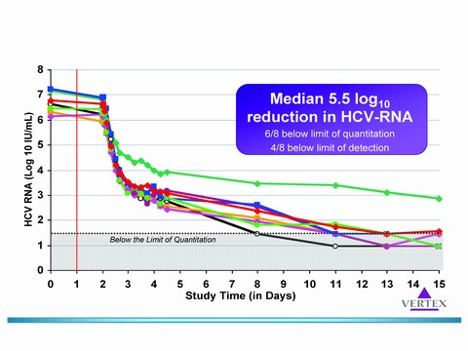
VX950 + Peg-IFN-a2a for 14 days
EXPECTED: 1st phase decline of 3-4 log (except 1 patient)
SURPRISING: 2nd phase slope > 1 log/week in 7/8 patients (and more)
Forestier et al, Hepatology, 2007

Slide 34
2nd phase slope (gen 1) with DIRECT anti-HCV anti-viral therapy
IFN-a based therapy
Wide distribution (0-0.9 log/wk, median 0.5)
protease inhibitors:
VX950 + Peg-IFN: CONSISTENT (7 / 8) RAPID (>1 log/wk)
VX950 + Peg-IFN + RBV: CONSISTENT (11 / 12) RAPID (>1 log/wk)
ScH 503034 + Peg-IFN: normal 2nd phase slope
polymerase inhibitors:
Idenix, Roche, Virapharm: normal 2nd phase slope
Merck: RAPID (>1 log/wk) in 2 Chimps
Notes:
Although much is known about the dynamics of HIV ,
still a very important question is left open:
Is HIV responsible (directly or indirectly)
for CD4 cells death in-vivo during progression to AIDS ?
In order to tackle this question,
and test the different models that may answer it,
we have presented to ourselves the next goals:
1) Study the dynamics of HIV replication in-vivo,
in addition to that of HIV decay,
which is what was mostly studied up to now.
2)
3)

Slide 35
INFECTED CELL as BLACK BOX
Model of Viral Dynamics on Cellular Infection (CI) level
Target Cell
Infected
Cell
δ
Virus
Notes:
Although much is known about the dynamics of HIV ,
still a very important question is left open:
Is HIV responsible (directly or indirectly)
for CD4 cells death in-vivo during progression to AIDS ?
In order to tackle this question,
and test the different models that may answer it,
we have presented to ourselves the next goals:
1) Study the dynamics of HIV replication in-vivo,
in addition to that of HIV decay,
which is what was mostly studied up to now.
2)
3)

Slide 36
Mixed levels (intra-cellular + circulation) generic model of anti-viral dynamics
Blocking of Intra-cellular production of RNA by RU
ε RNA = 99.0%
δ mode - 2nd phase viral decline determined by infected cell loss rate
Notes:
Although much is known about the dynamics of HIV ,
still a very important question is left open:
Is HIV responsible (directly or indirectly)
for CD4 cells death in-vivo during progression to AIDS ?
In order to tackle this question,
and test the different models that may answer it,
we have presented to ourselves the next goals:
1) Study the dynamics of HIV replication in-vivo,
in addition to that of HIV decay,
which is what was mostly studied up to now.
2)
3)

Slide 37
Mixed levels (intra-cellular + circulation) generic model of anti-viral dynamics
Blocking of Intra-cellular production of RNA by RU
εRNA = 99.99%
γ mode - 2nd phase viral decline determined by replication unit loss rate
Notes:
Although much is known about the dynamics of HIV ,
still a very important question is left open:
Is HIV responsible (directly or indirectly)
for CD4 cells death in-vivo during progression to AIDS ?
In order to tackle this question,
and test the different models that may answer it,
we have presented to ourselves the next goals:
1) Study the dynamics of HIV replication in-vivo,
in addition to that of HIV decay,
which is what was mostly studied up to now.
2)
3)

Slide 38
Mixed levels (intra-cellular + circulation) generic model of anti-viral dynamics
Blocking of Intra-cellular production of RNA by RU
ε RNA = 99.0% εRNA = 99.99%
δ mode - 2nd phase viral decline determined by infected cell loss rate
γ mode - 2nd phase viral decline determined by replication unit loss rate
Notes:
Although much is known about the dynamics of HIV ,
still a very important question is left open:
Is HIV responsible (directly or indirectly)
for CD4 cells death in-vivo during progression to AIDS ?
In order to tackle this question,
and test the different models that may answer it,
we have presented to ourselves the next goals:
1) Study the dynamics of HIV replication in-vivo,
in addition to that of HIV decay,
which is what was mostly studied up to now.
2)
3)

Slide 39
Mixed levels (intra-cellular + circulation) generic model of anti-viral dynamics
Blocking of Intra-cellular production of RNA by RU
ε _{IC} = 99.0% ε_{IC} = 99.99%
c
δ
σ
s.s.
δ mode - 2nd phase viral decline determined by infected cell loss rate
Notes:
Although much is known about the dynamics of HIV ,
still a very important question is left open:
Is HIV responsible (directly or indirectly)
for CD4 cells death in-vivo during progression to AIDS ?
In order to tackle this question,
and test the different models that may answer it,
we have presented to ourselves the next goals:
1) Study the dynamics of HIV replication in-vivo,
in addition to that of HIV decay,
which is what was mostly studied up to now.
2)
3)

Slide 40
Mixed levels (intra-cellular + circulation) generic model of anti-viral dynamics
Blocking of Intra-cellular production of RNA by RU
ε _{RNA} = 99.0% ε_{RNA} = 99.99%
c
δ
c
σ
s.s.
σ
γ
γ
δ mode - 2nd phase viral decline determined by infected cell loss rate
γ mode - 2nd phase viral decline determined by replication unit loss rate
Notes:
Although much is known about the dynamics of HIV ,
still a very important question is left open:
Is HIV responsible (directly or indirectly)
for CD4 cells death in-vivo during progression to AIDS ?
In order to tackle this question,
and test the different models that may answer it,
we have presented to ourselves the next goals:
1) Study the dynamics of HIV replication in-vivo,
in addition to that of HIV decay,
which is what was mostly studied up to now.
2)
3)

Slide 41
Mixed levels (intra-cellular + circulation) generic model of anti-viral dynamics
Blocking of Intra-cellular production of RNA by RU
ε _{RNA} = 99.0% ε_{RNA} = 99.99%
c
δ
c
σ
s.s.
σ
γ
γ
δ mode - 2nd phase viral decline determined by infected cell loss rate
γ mode - 2nd phase viral decline determined by replication unit loss rate
Notes:
Although much is known about the dynamics of HIV ,
still a very important question is left open:
Is HIV responsible (directly or indirectly)
for CD4 cells death in-vivo during progression to AIDS ?
In order to tackle this question,
and test the different models that may answer it,
we have presented to ourselves the next goals:
1) Study the dynamics of HIV replication in-vivo,
in addition to that of HIV decay,
which is what was mostly studied up to now.
2)
3)

Slide 42
Mixed levels (intra-cellular + circulation) generic model of anti-viral dynamics
Blocking of Intra-cellular production of RNA by RU
ε _{RNA} = 99.0% ε_{RNA} = 99.99%
δ
A critical threshold value of the effectiveness in blocking IC-RNA production by RU (ε_{C} = 1/R₀)
is needed to prevent a lower intra-cellular replication steady state and gives rise to a novel mode of viral decline depending on the rapid decay rate of the intra-cell replication-units rather than of the cells.
s.s.
γ +δ
γ
δ mode - 2nd phase viral decline determined by infected cell loss rate
γ mode - 2nd phase viral decline determined by replication unit loss rate
Prediction..
Switch in modes when switch to IFN based treatment..
Notes:
Although much is known about the dynamics of HIV ,
still a very important question is left open:
Is HIV responsible (directly or indirectly)
for CD4 cells death in-vivo during progression to AIDS ?
In order to tackle this question,
and test the different models that may answer it,
we have presented to ourselves the next goals:
1) Study the dynamics of HIV replication in-vivo,
in addition to that of HIV decay,
which is what was mostly studied up to now.
2)
3)

Slide 43
2 possible modes of HCV RNA decline with the new model combining INTRA-CELLULAR and cellular-level dynamics
ε < ε_{c} → δ–mode
ε > ε_{c} → γ–mode
δ
δ
HCV RNA (log IU/mL)
HCV RNA (log IU/mL)
HCV RNA (log IU/mL)
γ
γ

Slide 44
2 possible modes of HCV RNA decline with the new model combining INTRA-CELLULAR and Cellular-level dynamics
A new critical threshold in anti-viral effectiveness (ε_{c}) arises with the new model,
where:
When effectiveness is low (ε < ε_{c}):
Intra-cellular HCV RNA+ reaches a new lower equilibrium (reduced by ε%) and, after a time scale of 1/σ, the export rate of virions from the cell P(t) is approximately constant (similar to the 1998 model).
When effectiveness is high (ε > ε_{c}):
Intra-cellular HCV RNA+ (and the Replication Units) lose their steady-state and continuously decline in the cells, with the RU degradation rate (γ).
Note that δ is a host factor, while γ is a viral factor.
Thus, viral decline is in the delta-mode, where the 2nd phase slope depends only on the loss rate of infected cells (δ).
Thus, viral decline is in the gamma-mode, where the 2nd phase slope is a function of (γ + δ).

Slide 45
VX950 + Peg-IFN-a2a for 14 days
Slow 2nd phase in the “Outlier” patient is correlated with a blocking effectiveness lower than the critical threshold (measured at 2 days of treatment).

Slide 46
Evolution of resistance with Novel generation of therapy with DIRECT anti-viral against Hepatitis C DAV-C (STAT-C) therapy High (→ 100%) probability for existence of single (double) mutation resistant strains. Evolution dynamics of Resistance ? Effect of cell proliferation limits ? Effect of Intra-cellular replication dynamics ?
Notes:
Although much is known about the dynamics of HIV ,
still a very important question is left open:
Is HIV responsible (directly or indirectly)
for CD4 cells death in-vivo during progression to AIDS ?
In order to tackle this question,
and test the different models that may answer it,
we have presented to ourselves the next goals:
1) Study the dynamics of HIV replication in-vivo,
in addition to that of HIV decay,
which is what was mostly studied up to now.
2)
3)

Slide 47
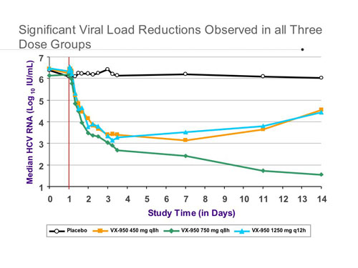
HCV rebound during direct anti-viral mono-therapy
EARLY HCV rebound (related to viral resistance to the drug) w/ telaprevir (or other direct anti-virals) mono-therapy treatment. In lower dosage groups viral rebound starts already at 3 days !!
Resistant virus (>5% of total virus) already at day 2 in some patients.
In comparison, HIV rebound starts, in general, after 14 days only.
Viral kinetics during mono-therapy with telaprevir at different doses for 14 days
Reesink et al, Gastroenterology, 2006

Slide 48
Cellular-level (CI) resistance evolution model
Target Cell
WT Infected
Cell
Mut
Infected
Cell
Wt
Virus
p_{res}
p_{wt}
Mut
Virus
Number of TARGET CELLS NEEDS to INCREASE SIGNIFICANTLY and NOT REALISTICALLY ALREADY in 1-2 DAYS
Notes:
Although much is known about the dynamics of HIV ,
still a very important question is left open:
Is HIV responsible (directly or indirectly)
for CD4 cells death in-vivo during progression to AIDS ?
In order to tackle this question,
and test the different models that may answer it,
we have presented to ourselves the next goals:
1) Study the dynamics of HIV replication in-vivo,
in addition to that of HIV decay,
which is what was mostly studied up to now.
2)
3)

Slide 49
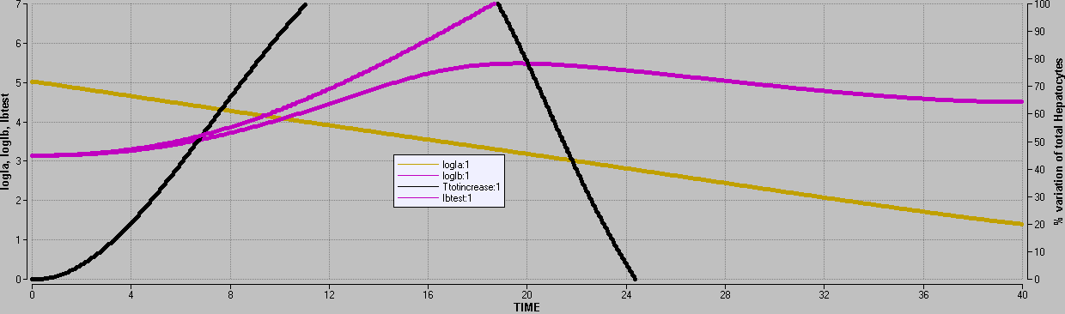
Cellular-level resistance evolution model
In order to obtain viral rebound in 3 days , it is needed that
Rapid loss rate of infected cells (t½ < 1 day ) (as in HIV) and rapid proliferation rate of Hepatocytes (t₂>1 day)
Increase in total number of hepatocytes by 50% in 3 days
NOT BIOLOGICALLY REALISTIC for chronic HCV

Slide 50
Differences in development of viral RESISTANCE
Mutation
Selection
Amplification
HIV: at cell infection at cell infection all progeny virus
RT -> integration infected cell for next cell infection cycle
HBV: at virus formation at cell infection next cell infection cycle
polym → formation at next cell infection progeny of next of genomic HBV-DNA cell infection
HCV: at RNA replication at RNA replication at RNA replication
RNA- → RNA+
Notes:
Although much is known about the dynamics of HIV ,
still a very important question is left open:
Is HIV responsible (directly or indirectly)
for CD4 cells death in-vivo during progression to AIDS ?
In order to tackle this question,
and test the different models that may answer it,
we have presented to ourselves the next goals:
1) Study the dynamics of HIV replication in-vivo,
in addition to that of HIV decay,
which is what was mostly studied up to now.
2)
3)

Slide 51
INTRA-CELLULAR (IC)
EVOLUTION OF RESISTANCE
δ
Target Cell
Mut
Replication Unit
γ
Mut
RNA+
P_{Mut}
WT
Replication Unit
WT+Mut
Free
Virus
P_{WT}
WT+Mut
Free
Virus
WT
RNA+
Infected
Cell
Notes:
Although much is known about the dynamics of HIV ,
still a very important question is left open:
Is HIV responsible (directly or indirectly)
for CD4 cells death in-vivo during progression to AIDS ?
In order to tackle this question,
and test the different models that may answer it,
we have presented to ourselves the next goals:
1) Study the dynamics of HIV replication in-vivo,
in addition to that of HIV decay,
which is what was mostly studied up to now.
2)
3)

Slide 52
INTRA-CELLULAR (IC)
EVOLUTION OF RESISTANCE
δ
Target Cell
Mut
Replication Unit
Mut
RNA+
ε_{Mut}
WT
Replication Unit
WT+Mut
Free
Virus
WT+Mut
Free
Virus
WT
RNA+
ε_{WT}
Infected
Cell
Notes:
Although much is known about the dynamics of HIV ,
still a very important question is left open:
Is HIV responsible (directly or indirectly)
for CD4 cells death in-vivo during progression to AIDS ?
In order to tackle this question,
and test the different models that may answer it,
we have presented to ourselves the next goals:
1) Study the dynamics of HIV replication in-vivo,
in addition to that of HIV decay,
which is what was mostly studied up to now.
2)
3)

Slide 53
Intra-Cellular + Cell Infection (ICCI) Model
Important parameters
Relative Fitness (RF) = R_{0Mut} / R_{0WT} , approx: P_{Mut}/P_{WT}
assuming all other parameters equal for WT and Mut
and approx same effect for difference in other parameters
Relative Resistance (RRes) = (1-ε_{Mut}) / (1-ε_{WT})
Delta (δ) = loss rate of infected cells
κ = Mutation rate; γ ; σ ; α ; ρ
Notes:
Although much is known about the dynamics of HIV ,
still a very important question is left open:
Is HIV responsible (directly or indirectly)
for CD4 cells death in-vivo during progression to AIDS ?
In order to tackle this question,
and test the different models that may answer it,
we have presented to ourselves the next goals:
1) Study the dynamics of HIV replication in-vivo,
in addition to that of HIV decay,
which is what was mostly studied up to now.
2)
3)

Slide 54
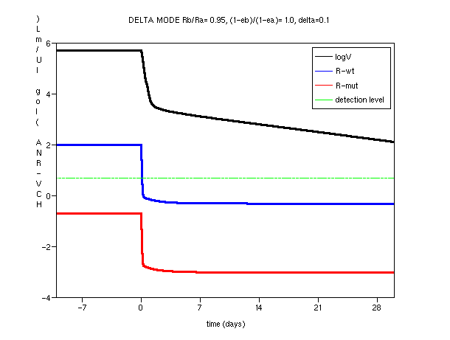
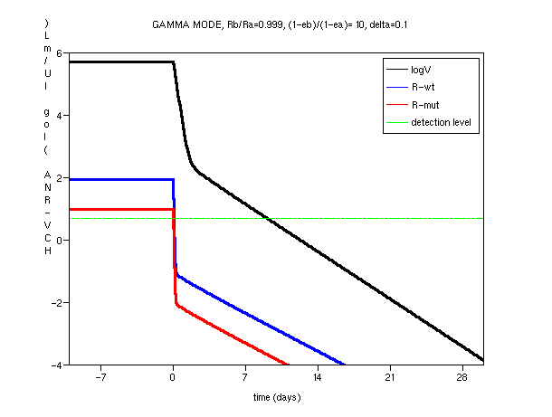
Mixed levels (intra-cellular + circulation) Gamma-mode vs delta-mode
RF x RRes < 1 → WT dom Mut RF x RRes < 1 ( or >1 )
εwt < εc & εwt > εc & εmut > εc
δ mode - 2nd phase viral decline determined by infected cell loss rate
γ mode - 2nd phase viral decline determined by replication unit loss rate
Notes:
Although much is known about the dynamics of HIV ,
still a very important question is left open:
Is HIV responsible (directly or indirectly)
for CD4 cells death in-vivo during progression to AIDS ?
In order to tackle this question,
and test the different models that may answer it,
we have presented to ourselves the next goals:
1) Study the dynamics of HIV replication in-vivo,
in addition to that of HIV decay,
which is what was mostly studied up to now.
2)
3)

Slide 55
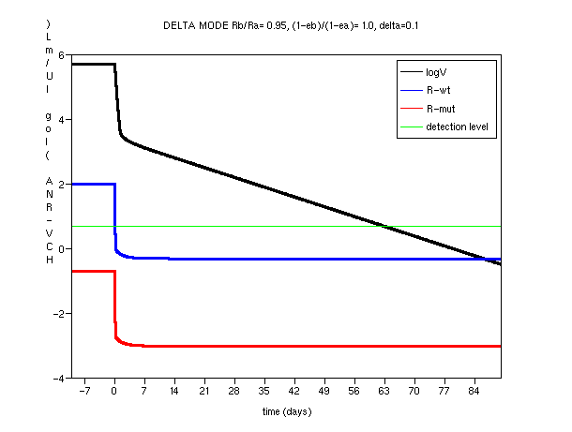
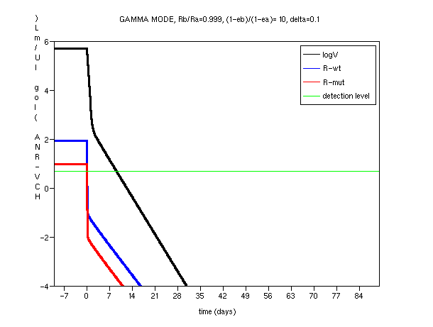
Mixed levels (intra-cellular + circulation) Long term Clinical Implication
RF x RRes < 1 → WT dom Mut RF x RRes < 1 or >1
Ewt < Ec Ewt > Ec & Emut > Ec
δ mode - 2nd phase viral decline determined by infected cell loss rate
γ mode - 2nd phase viral decline determined by replication unit loss rate
Possible SVR after 12 weeks
Notes:
Although much is known about the dynamics of HIV ,
still a very important question is left open:
Is HIV responsible (directly or indirectly)
for CD4 cells death in-vivo during progression to AIDS ?
In order to tackle this question,
and test the different models that may answer it,
we have presented to ourselves the next goals:
1) Study the dynamics of HIV replication in-vivo,
in addition to that of HIV decay,
which is what was mostly studied up to now.
2)
3)

Slide 56
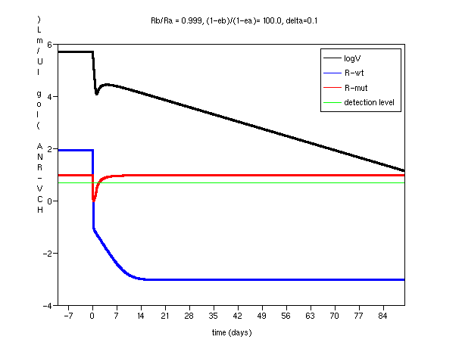
Mixed levels (intra-cellular + circulation) Delta mode with WT or Mut dominant
RF x RRes >1 → Mut dominant
& Ewt > Ec & Emut < Ec
RF x RRes < 1 → WT dominant
& Ewt < Ec
δ mode - 2nd phase viral decline determined by infected cell loss rate
δ mode - 2nd phase viral decline determined by infected cell loss rate
Notes:
Although much is known about the dynamics of HIV ,
still a very important question is left open:
Is HIV responsible (directly or indirectly)
for CD4 cells death in-vivo during progression to AIDS ?
In order to tackle this question,
and test the different models that may answer it,
we have presented to ourselves the next goals:
1) Study the dynamics of HIV replication in-vivo,
in addition to that of HIV decay,
which is what was mostly studied up to now.
2)
3)

Slide 57
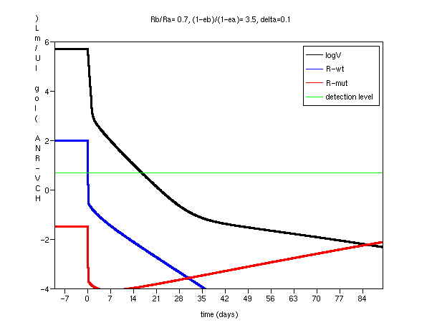
Mixed levels (intra-cellular + circulation) Possible Mode Switch
10 > RF x RRes >1 → Mut dom Mut RF x RRes < 1 or >1
& 0.9Ec < Emut < Ec & Ewt > Ec & Emut > Ec
γ mode switch to δ mode
γ mode - 2nd phase viral decline determined by replication unit loss rate
Notes:
Although much is known about the dynamics of HIV ,
still a very important question is left open:
Is HIV responsible (directly or indirectly)
for CD4 cells death in-vivo during progression to AIDS ?
In order to tackle this question,
and test the different models that may answer it,
we have presented to ourselves the next goals:
1) Study the dynamics of HIV replication in-vivo,
in addition to that of HIV decay,
which is what was mostly studied up to now.
2)
3)

Slide 58
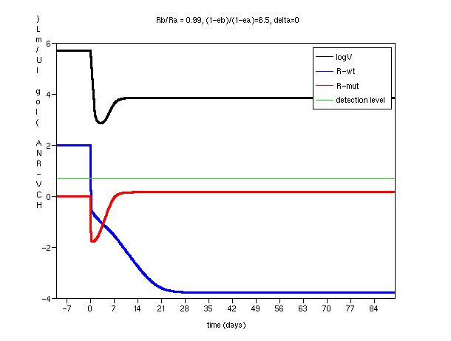
Mixed levels (intra-cellular + circulation) Rebound with Resistant Virus
RF x RRes > 1 → Mut dom Mut RF x RRes >1 → Mut dom
& Emut > Ec & Delta→0 & Ewt < Ec & Emut > Ec
δ mode - 2nd phase viral decline determined by infected cell loss rate
Viral Rebound with new steady state
Notes:
Although much is known about the dynamics of HIV ,
still a very important question is left open:
Is HIV responsible (directly or indirectly)
for CD4 cells death in-vivo during progression to AIDS ?
In order to tackle this question,
and test the different models that may answer it,
we have presented to ourselves the next goals:
1) Study the dynamics of HIV replication in-vivo,
in addition to that of HIV decay,
which is what was mostly studied up to now.
2)
3)

Slide 59
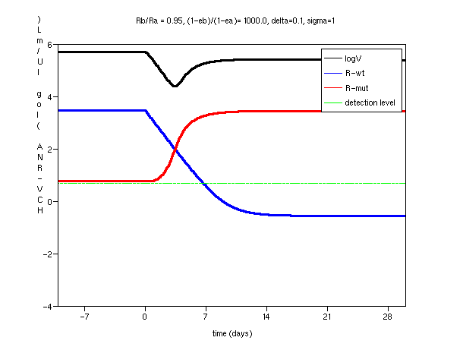
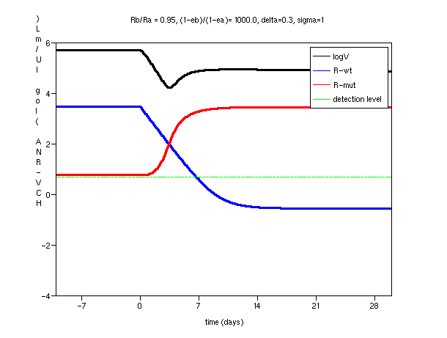
Mixed levels (intra-cellular + circulation) Rebound with Resistant Virus
RF x RRes >>> 1 → Mut dom Mut RF x RRes >>> 1 → Mut dom
& Emut > Ec & Delta→0 & Emut > Ec even with Delta > 0.1
Viral Rebound with quasi steady state
Independent of delta
Viral Rebound with high steady state
Notes:
Although much is known about the dynamics of HIV ,
still a very important question is left open:
Is HIV responsible (directly or indirectly)
for CD4 cells death in-vivo during progression to AIDS ?
In order to tackle this question,
and test the different models that may answer it,
we have presented to ourselves the next goals:
1) Study the dynamics of HIV replication in-vivo,
in addition to that of HIV decay,
which is what was mostly studied up to now.
2)
3)

Slide 60
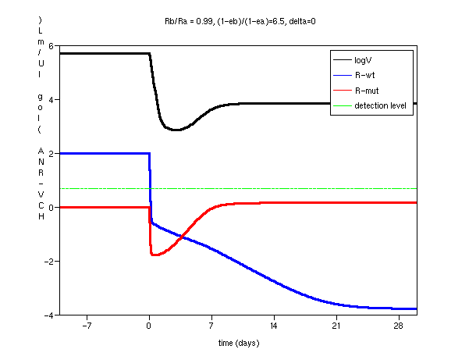
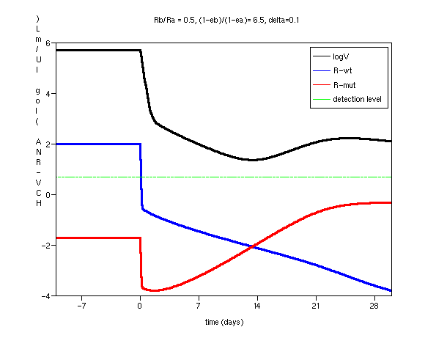
Mixed levels (intra-cellular + circulation) Transient Rebound with Resistant Virus
RF x RRes > 1 → Mut dom Mut RF x RRes > 1 → Mut dom
& Emut > Ec & Delta→0 & Emut > Ec but Delta > 0.1
Viral Rebound with new steady state
TRANSIENT Viral Rebound followed by delta-mode decline
Notes:
Although much is known about the dynamics of HIV ,
still a very important question is left open:
Is HIV responsible (directly or indirectly)
for CD4 cells death in-vivo during progression to AIDS ?
In order to tackle this question,
and test the different models that may answer it,
we have presented to ourselves the next goals:
1) Study the dynamics of HIV replication in-vivo,
in addition to that of HIV decay,
which is what was mostly studied up to now.
2)
3)

Slide 61
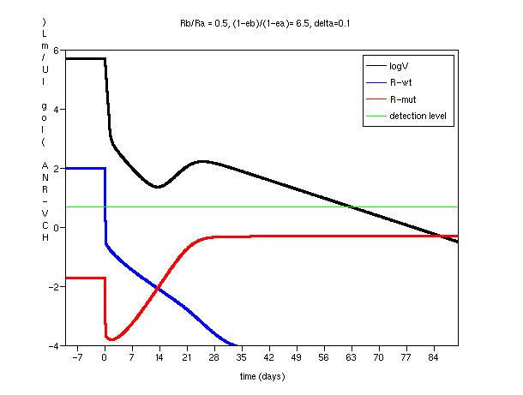
Mixed levels (intra-cellular + circulation) Transient Rebound -> delta decline
RF x RRes > 1 → Mut dom Mut RF x RRes > 1 → Mut dom
& Emut > Ec & Delta→0 & Emut > Ec but Delta > 0.1
Viral Rebound with new steady state
TRANSIENT Viral Rebound followed by delta-mode decline
Notes:
Although much is known about the dynamics of HIV ,
still a very important question is left open:
Is HIV responsible (directly or indirectly)
for CD4 cells death in-vivo during progression to AIDS ?
In order to tackle this question,
and test the different models that may answer it,
we have presented to ourselves the next goals:
1) Study the dynamics of HIV replication in-vivo,
in addition to that of HIV decay,
which is what was mostly studied up to now.
2)
3)

Slide 62
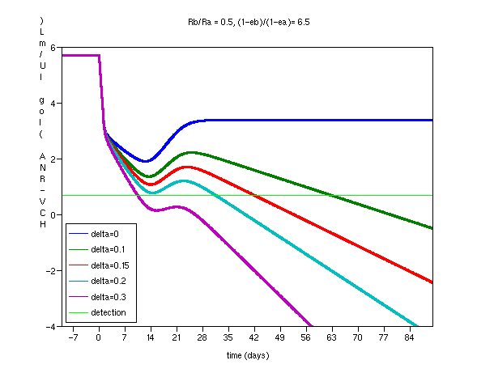
Mixed levels (intra-cellular + circulation) Eradication with Fully Resistant Virus
RF x RRes > 1 → Mut dom Mut RF x RRes > 1 → Mut dom
& Emut > Ec & Delta >> 0.1 & Emut > Ec but Delta > 0.1
TRANSIENT Viral Rebound may lead to viral eradication
TRANSIENT Viral Rebound followed by delta-mode decline
Notes:
Although much is known about the dynamics of HIV ,
still a very important question is left open:
Is HIV responsible (directly or indirectly)
for CD4 cells death in-vivo during progression to AIDS ?
In order to tackle this question,
and test the different models that may answer it,
we have presented to ourselves the next goals:
1) Study the dynamics of HIV replication in-vivo,
in addition to that of HIV decay,
which is what was mostly studied up to now.
2)
3)

Slide 63
Conclusions – dynamical aspects
We present a new math model for HCV viral dynamics and resistance evolution on both intra-cellular level and cell infection levels.
Occurrence of the mutation , selection and amplification processes intra-cellularly with a more rapid time-scale than cell-infection rates allows for a more rapid evolution of resistance with the same mutation rate.
Furthermore, the interplay between the intra-cell viral evolution dynamics and the cell infection dynamics gives rise to a richer repertoire of viral kinetics/evolution patterns than with the previous model of cell infection level only.
Notes:
Although much is known about the dynamics of HIV ,
still a very important question is left open:
Is HIV responsible (directly or indirectly)
for CD4 cells death in-vivo during progression to AIDS ?
In order to tackle this question,
and test the different models that may answer it,
we have presented to ourselves the next goals:
1) Study the dynamics of HIV replication in-vivo,
in addition to that of HIV decay,
which is what was mostly studied up to now.
2)
3)

Slide 64
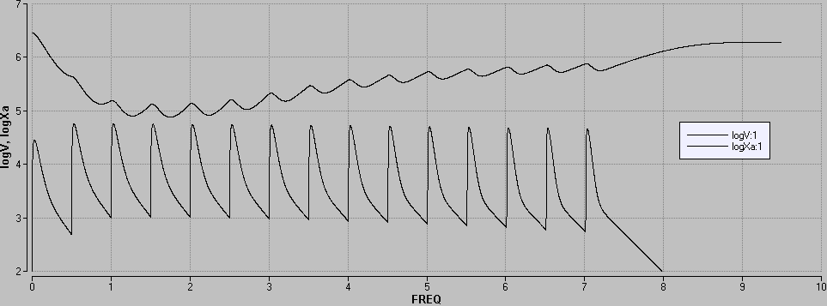
Fitting of PK/VK with ICCI model
Model allows to estimate PD parameters from PK/VK data IF measured FREQUENT enough at specific times
Adequate sampling of VK and PK allows for determination of IN-VIVO pharmacodynamical parameters (Ec90 etc)
Days (Simulated hypothetical drug effect)

Slide 65
Blocking Effectiveness
as function of IFN level
Serum IFN (log pg/ml)
ε
Effmax * LIFN ^{N}
(LIFN) =
Ec50 ^{N}
+ LIFN ^{N}
Blocking Effectiveness
IFN level
Estimation of PD parameters
Ec50 (Ec90)= sensitivity to IFN
Effmax
N = 2nd order sensitivity to IFN
HCV RNA (log IU/ml)

Slide 66
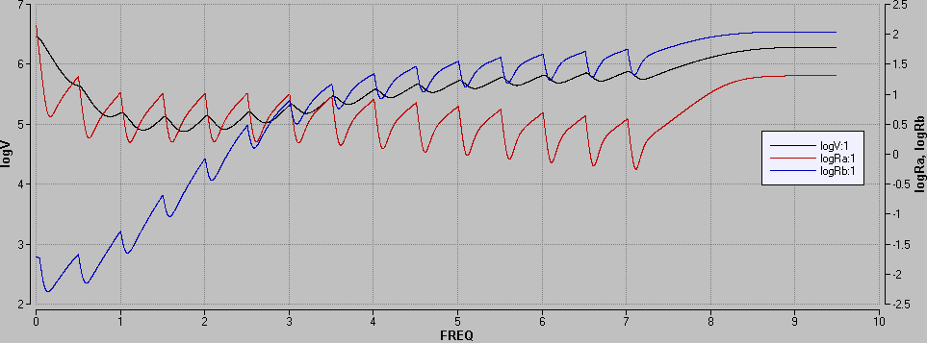
Resistance Evolution with ICCI model
Model allows to predict Relative-fitness and resistance profiles IF PK/VK (and sequence) data available at rebound / slowing
Adequate sampling of VK and PK allows for determination of IN-VIVO RELATIVE-FITNESS x Resistance
Days (Simulated hypothetical drug effect)

Slide 67
Conclusions – clinical implications
The new model reproduces viral kinetics and resistance evolution patterns observed in-vivo with direct anti-HCV.
In particular, clinically important patterns are: - Switch from early rapid gamma-mode to a late delta-mode, which may give rise to lack of SVR in 12 weeks if delta is slow. - A transient rebound followed by delta-mode decline, which may allow for SVR in 12 weeks even if fully resistant virus developed during mono-therapy, IF delta is rapid.
The main dynamical parameters can be estimated by fitting the observed data to the model - analytical solution then allows to predict which kinetic / resistance-evolution pattern will be achieved as early as 2 weeks (not shown).
Notes:
Although much is known about the dynamics of HIV ,
still a very important question is left open:
Is HIV responsible (directly or indirectly)
for CD4 cells death in-vivo during progression to AIDS ?
In order to tackle this question,
and test the different models that may answer it,
we have presented to ourselves the next goals:
1) Study the dynamics of HIV replication in-vivo,
in addition to that of HIV decay,
which is what was mostly studied up to now.
2)
3)

Slide 68
Ongoing / Future Projects - “Basic” Science
De-simplification of the biological level of the model
→ to allow better identification of the different model components
- Inclusion of variable for different enzymes (protease, polymerase)
Generalization and de-approximation of mean-field approx of model
→ to allow dynamics of individual cells with distribution
different intra-cellular replication dynamics and viral strains
- Use of PDE instead of ODE to take into consideration cell “age”
- Stochastic simulations to test the continuous deterministic model
Generalization to a better representation of multiple strains
→ to allow continuous/stepwise resistance evolution of strains
- Use of strain indexing, with vectors for the different parameters
- Use of PDE for strain characteristic space – Rel-Fitness, Rel-Resist

Slide 69
Multi-level (ICCI) Intra-Cellular + Cell Infection generic model of anti-viral dynamics
Infected
Cell
δ
Target Cell
Polymerase
Protease
v
Replic UNIT
v
v
Packed virus
Intra-cell RNA
Virus
γ
Notes:
Although much is known about the dynamics of HIV ,
still a very important question is left open:
Is HIV responsible (directly or indirectly)
for CD4 cells death in-vivo during progression to AIDS ?
In order to tackle this question,
and test the different models that may answer it,
we have presented to ourselves the next goals:
1) Study the dynamics of HIV replication in-vivo,
in addition to that of HIV decay,
which is what was mostly studied up to now.
2)
3)

Slide 70
Ongoing / Future Projects - “Translational”
Bridging in-vitro results and in-vivo modeling
→ to allow prediction of in-vivo pharmacodynamics from in-vitro estimates
- Inclusion of drug-enzyme (protease, polymerase) interactions
- Link to Modeling of in-vitro assay results
Analytical solutions / approximations of the model
→ to allow better prediction of the different patterns of viral decline
and/or or viral resistance evolution.
De-coupling of the estimates for related parameters
→ to allow better estimates of each effect separately
Analysis of parameter identifiability
→ to allow sampling protocol optimization
- Analytical analysis by maximum likelihood approaches
- Numerical analysis by Monte-Carlo simulation

Slide 71
Analysis of Parameter Identifiability
Monte-Carlo approach: model simulated; sampled every X hrs; Y% noise added; N replicas made; each replica fitted by model
Preliminary results – only for Ec50 ; N=20 ; Noise Y = ±15% of logVL
Sampling Orig Err Avg Err STD-Err Max-Err
Ec50 estimated wt mut wt mut wt mut wt mut
Day 0-9: q2 hrs 0.02% 0.01% 1.2% 1.5% 0.4% 0.8% 1.8% 2.3%
Day 0-2: q2 hrs 0.12% 99.9% 1.7% 71% 0.9% 22% 2.8% 96%
Day 0-2: q2 hrs 0.01% 0.04% 1.7% 3.7% 0.9% 3.7% 2.9% 9.9%
+ days 2-7: qd
Day 0-2: q2 hrs 0.01% 0.01% 1.7% 2.6% 0.9% 1.8% 2.9% 4.9%
+ days 3-5 + days 5-7: q2 hrs
Day 0-2: q2 hrs 4.4% ---- 4.3% ---- 2.4% ----- 7.1% ----
with CI Model

Slide 72
Analysis of Parameter Identifiability
Monte-Carlo approach: model simulated; sampled every X hrs; Y% noise added; N replicas made; each replica fitted by model
Preliminary results – fit only for Ec50 ; N=20 ; Noise Y = ±15% of logVL
Sampling Orig Err Avg Err STD-Err Max-Err
Ec50 estimated wt mut wt mut wt mut wt mut
Day 0-9: q2 hrs 0.02% 0.01% 1.2% 1.5% 0.4% 0.8% 1.8% 2.3%
Day 0-9: q4 hrs 0.01% 0.02% 1.1% 1.4% 0.4% 0.9% 1.6% 2.3%
Day 0-2: q4 hrs 0.00% 0.04% 1.4% 2.7% 0.6% 2.7% 2.2% 5.9%
+ days 2-7: qd
Day 0-9: q8 hrs 0.01% 0.02% 10% 11% 4.5% 6.9% 26% 32%
(over optimistic estimate – only Ec50 estimated and all other parameters kept – need to fit with full parameter set)

Slide 73
Acknowledgements
The Mina & Ervard Goodman Faculty of Life Sciences, Bar-Ilan University
Laboratory for Modeling In-patient Pathogen and Immune Dynamics
The Mina & Ervard Goodman Faculty of Life Sciences
Bar-Ilan University, Ramat-Gan, Israel
HBV HCV Computational
Yafit Maayan Jeremie Guedj Ronen Tal
David Burg Esther Hagai Moshe Mishan
HIV Rachel Drummer-Levi Lee Ben-Ami
Jessica Rose Lynn Rozenberg Sean Miller
David Shalom Harel Dahari
Lupus and Immune Regulation Project Manager
Arnon Arazi Yonit Homburger
Asher Uziel

